Slide 1
School of Natural Sciences
Vision & Mission Sessions
February 5, 2020
Center of Institutional Effectiveness

Slide 2
Lateral Thinking
Someone falls out of a thirty story building, but lives. With luck and their landing pad not being factors, how could they have survived the fall?
There are a dozen eggs in a carton. Twelve people each take a single egg, but there is one egg left in the carton. How?
There are ten birds perched on a fence. A farmer aims his rifle and shoots one. How many birds are left?
What weighs more
100 pounds of feathers,
or 100 pounds of quarters?
A boat has a ladder that’s ten feet long, and hangs off the side of the boat, with its last two feet submerged in water. If the ocean tide rises five feet, how much of the ladder will be underwater?
If you were alone in a dark cabin, with only one match and a lamp, a fireplace, and a candle to choose from, which would you light first?
Notes:
https://blog.udemy.com/lateral-thinking-questions/

Slide 3
Vision – Mission - Values
Vision Statement: Your transcendent business purpose. What you stand for. The star on the horizon to be chased. Your enduring, ultimate purpose. It serves as inspiration for your employees and your external audiences.
Mission Statement: Your transactional business purpose. The things you do to achieve your vision. A compass to reach that star on the horizon. Ultimately, it keeps people focused on what will drive business results. It serves as a source of direction.
Values: Your fundamental principles of operation. The best behaviors of your best employees on their best days. Daily guides for action along your journey. The fundamental principles by which a business operates.
Notes:
https://gobraithwaite.com/what-are-mission-vision-and-purpose-statements/

Slide 4
Why
https://www.ted.com/talks/simon_sinek_how_great_leaders_inspire_action?language=en#t-164380

Slide 5
Why Exercise
What’s Your Purpose?
What’s Your Cause?
What’s Your Belief?
Why Does Your Organization Exist?
Why Do You Get Out of Bed in the Morning?
Why Should Anyone Care?
Simon Sinek

Slide 6
Vision – Why you do what you do?
Working hard for something we don’t care about is called stress.
Working hard for something we love is called passion.
Simon Sinek
Why do you dedicate your life to your work?

Slide 7
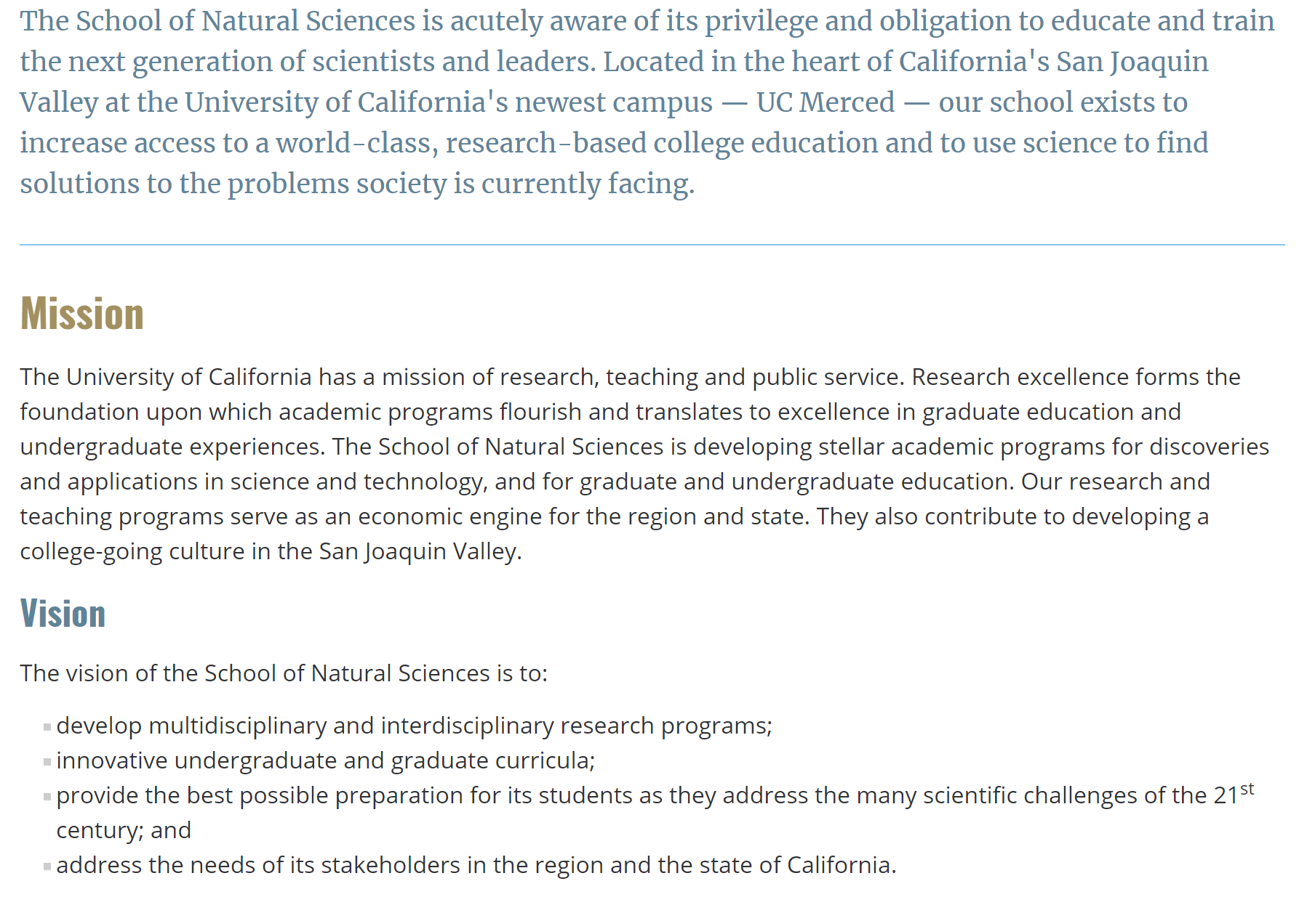
School of Natural Sciences – Vision Who is Our Audience?

Slide 8
Vision – Why you do what you do?
Why did you choose UC Merced?
What gets you excited to come to work?

Slide 9
Elevator Pitch
Why Program X?
Why @UCM?
(What is distinct about our way?)

Slide 10
Loglines
According to molecular biologist John Medina of the University of Washington School of Medicine, the human brain craves meaning before details. When a listener doesn’t understand the overarching idea being presented in a pitch, they have a hard time digesting the information. A logline will help you paint the big picture for your audience.
A police chief, with a phobia for open water, battles a gigantic shark with an appetite for swimmers and boat captains, in spite of a greedy town council who demands that the beach stay open.

Slide 11
Loglines
Writing a logline forces you to answer questions like:
Who is my protagonist?
What do he/she/it/they want?
Who/What is against my protagonist?
Why is vital for my protagonist to achieve his/her/their goal?
And if you cannot answer those questions, you may have to rethink some things…

Slide 12
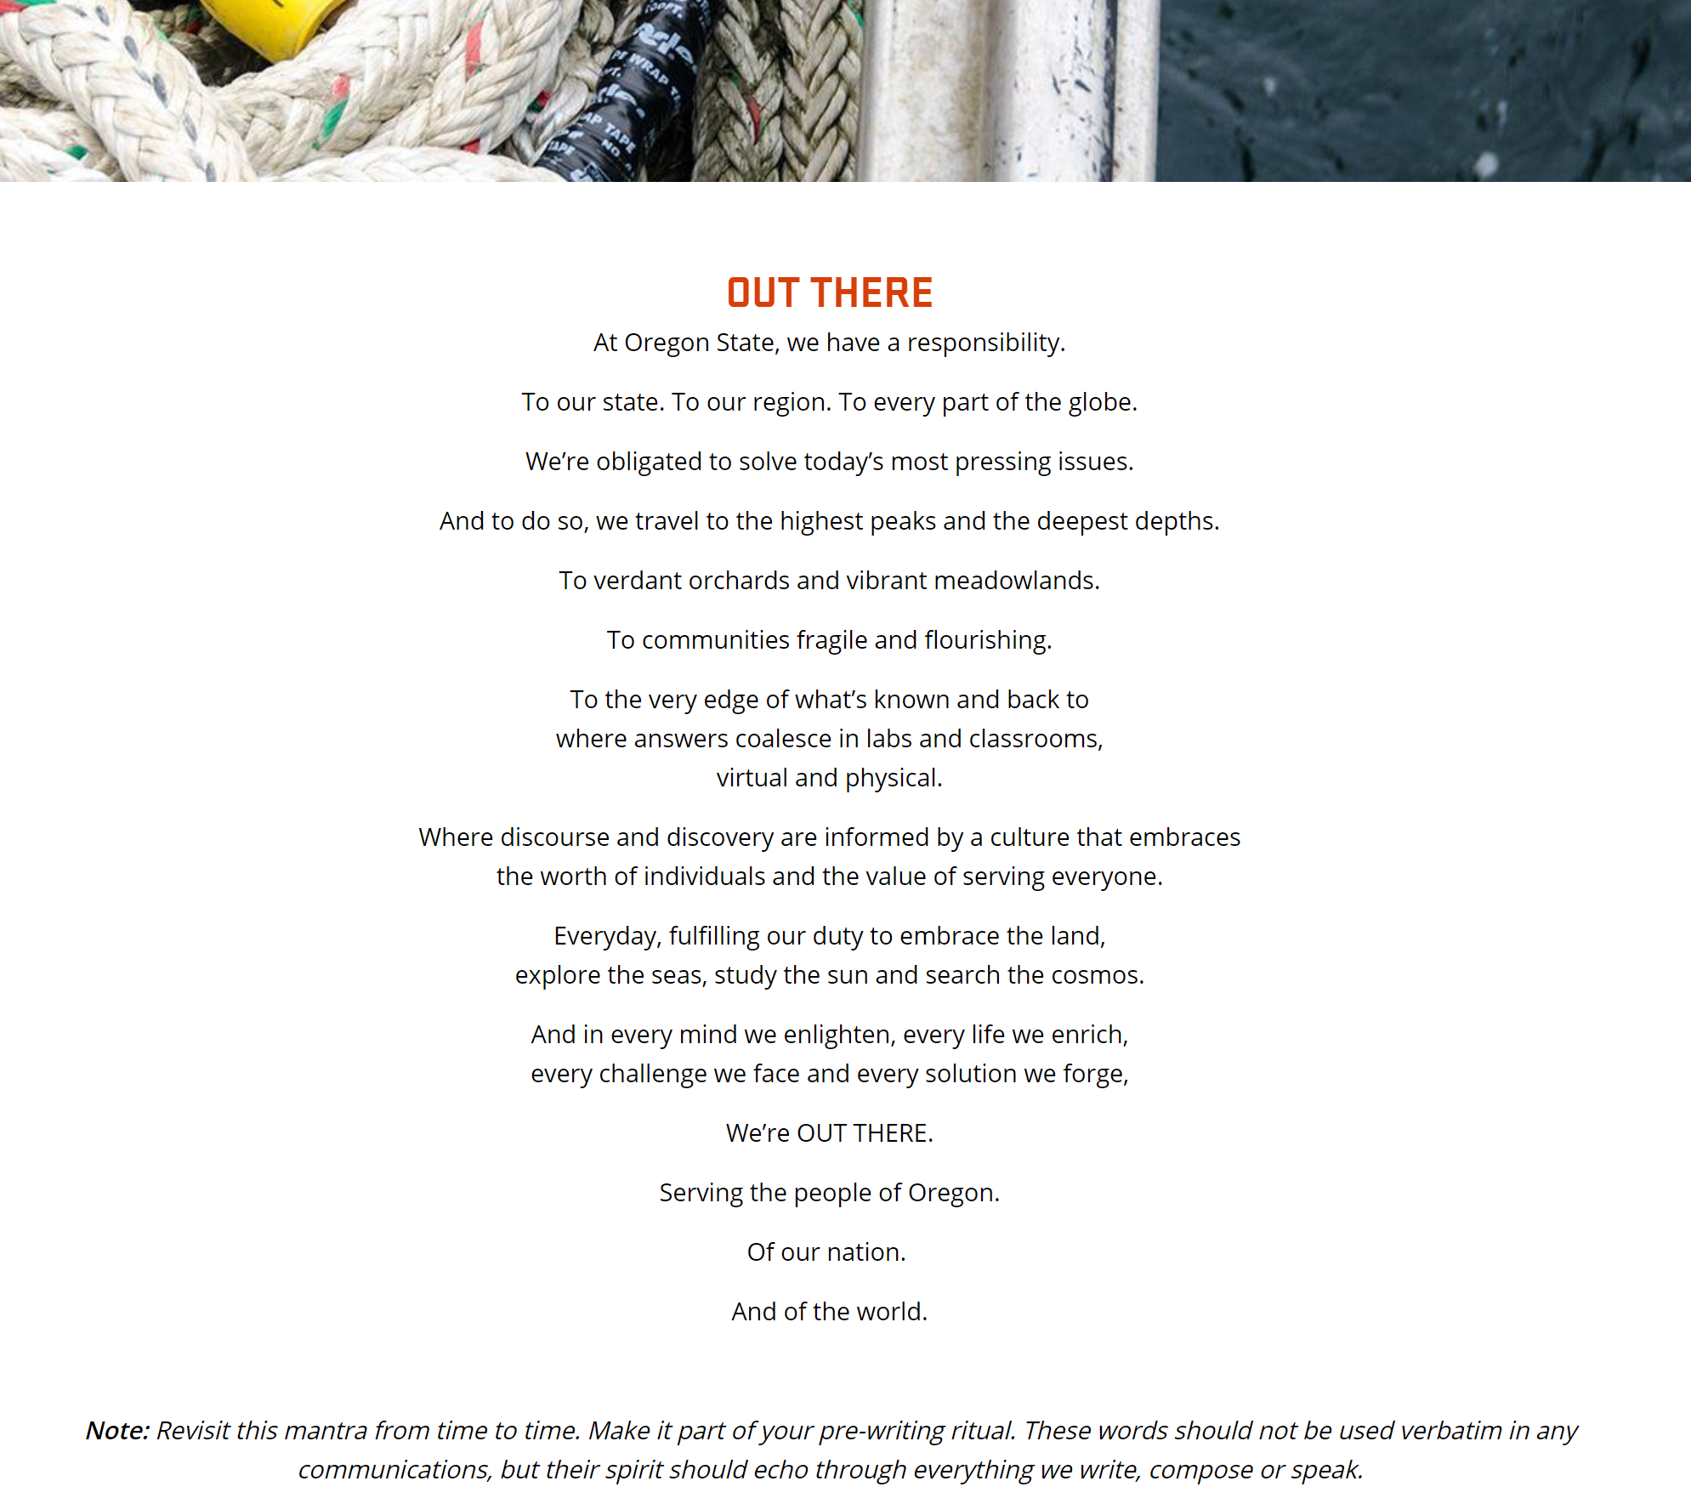
Dialogue

Slide 13
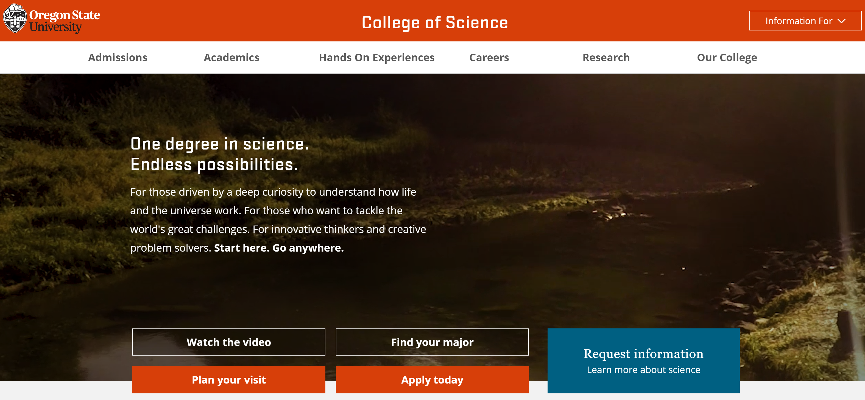
Dialogue

Slide 14
Vision – Why you do what you do?
Smithsonian: Shaping the future by preserving our heritage, discovering new knowledge, and sharing our resources with the world

Slide 15
Example – Oregon State University
Tagline
One degree in science. Endless possibilities.
For those driven by a deep curiosity to understand how life and the universe work. For those who want to tackle the world's great challenges. For innovative thinkers and creative problem solvers. Start here. Go anywhere.
Mission, vision and values
Pursuing fundamental research and transformative education for a better future
Mission
To advance science and build global leaders for a healthy people, living on a healthy planet, in a healthy economy.
Vision
Driven by unbridled curiosity, our students and scientists unlock how Life and the Universe work.
Together we will
ignite a passion for science in all learners,
thrive in a data rich world,
Improve human and ocean health,
develop sustainable materials to power our planet, and move discoveries from the lab to people's lives.
Values
Our people—our students, faculty, staff, alumni—and their successes.
Fundamental research for a better future.
Collaboration to solve the world’s problems and create opportunities.
Meaningful experiences that transform lives.
Outstanding teaching for engaging learners.
Diversity to build the best teams to do the best science.
An inclusive community.
Scientific literacy for all.

